Slide 1
Welcome to CS10 Group Seventh Meeting
Team member
Wilma Liu (Leader)
Fiona Hu
Pat Zhang
Elvia Tong
Reehaa Ding
William Quan

Slide 2
This week meeting schedule
The overall timeline
- What we did in the previous weeks
- What we plan to do in the next couple weeks
The overall project frame
- Connect with two topics (Tourism & Business close)
- Connect with the project purpose & aim

Slide 3
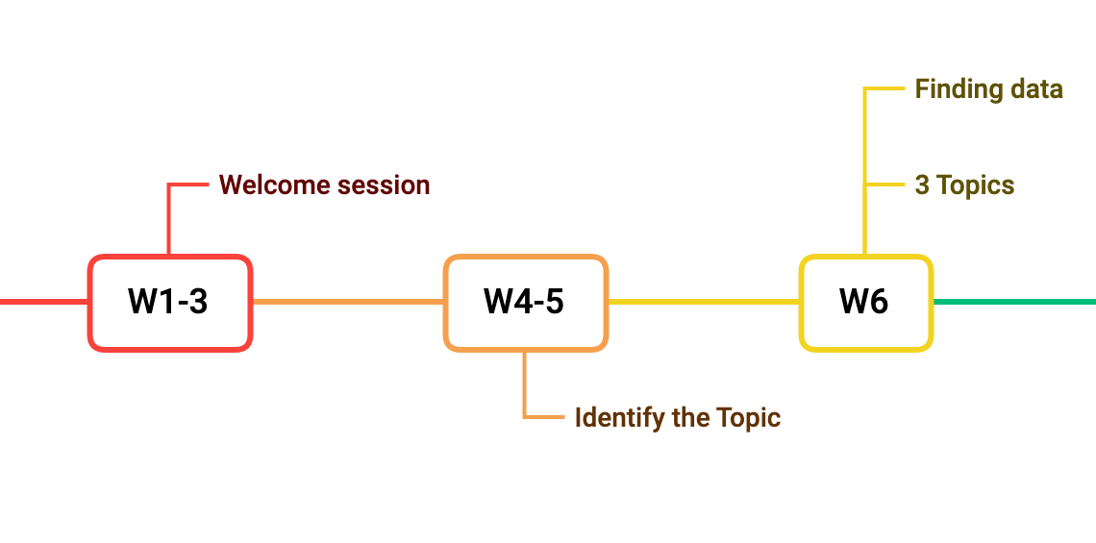
The project timeline

Slide 4
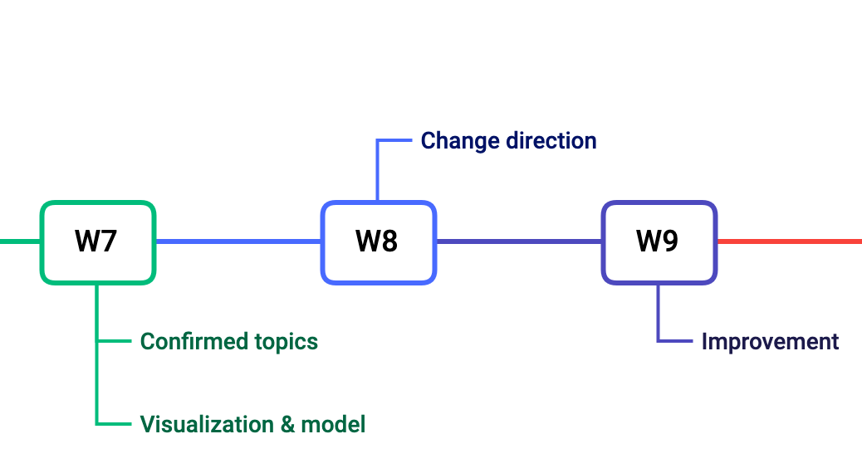
The project timeline

Slide 5
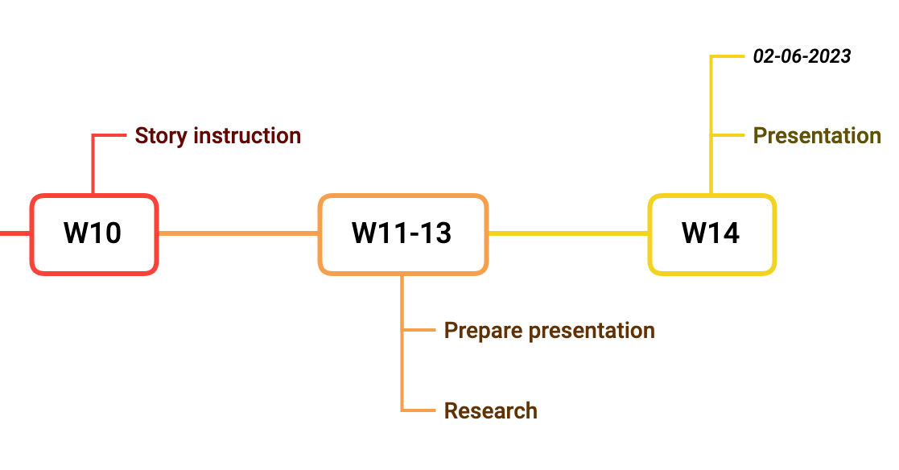
The project timeline

Slide 6
The overall project framework - Tourism
Background: COVID-19
Why tourism and what is impact of COVID-19?
Who is involved in tourism management?
Economic reasons for government involvement in tourism
Connect model output with tourism support
Tourism support recommendations

Slide 7
Why tourism and what is impact?
The main economic and employment source in Australia and NSW
One of the industries most affected by COVID-19
Relatively few specific tourism support programs and grants
Produce direct and indirect impacts to other industries

Slide 8
Who is involved in tourism management?
Government at all levels
- from national and federal governments, through to local governments at the village level
National tourism organizations (NTOs)
- have interests in a wide range of issues such as social, economic, environment and moral problems

Slide 9
Economic reasons for government involvement in tourism
A boost to the national economy generally
Having a multiplier effect by helping other sectors of the economy
Important foreign currency earner

Slide 10
Review: The LSTM model of tourism
The number of arrivals
1) Monthly data
2) From 1991 to 2023
Two machine learning ways for time series data
1) LSTM model
2) Transformer model

Slide 11
The potential improvement of the model
Change one FC layer to convolutional layer
Test different setting of hyper-parameters
Choose different loss function
Try different optimizers
……

Slide 12
Connect model output with tourism support
The model output
- the prediction of tourists arrivals in NSW and Australia
- When will it return to the level before the epidemic?
Tourism support
- What kinds of support can be provided during the stage of recovery and post COVID-19?

Slide 13
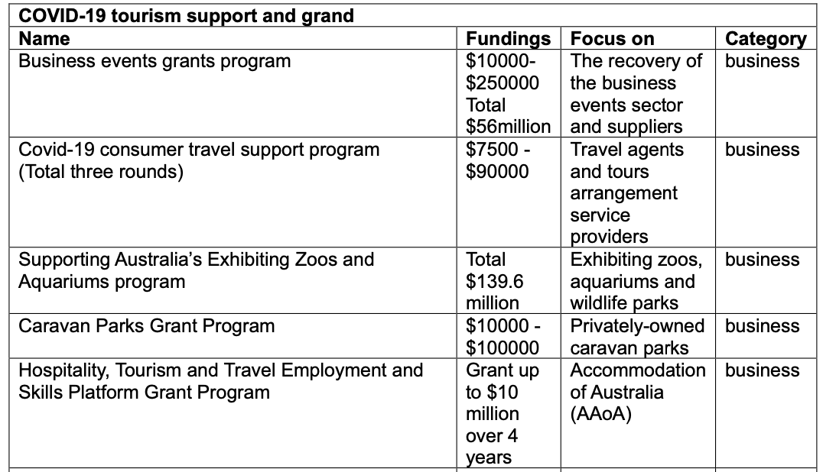
Connect model output with tourism support
Tourism support from federal government

Slide 14
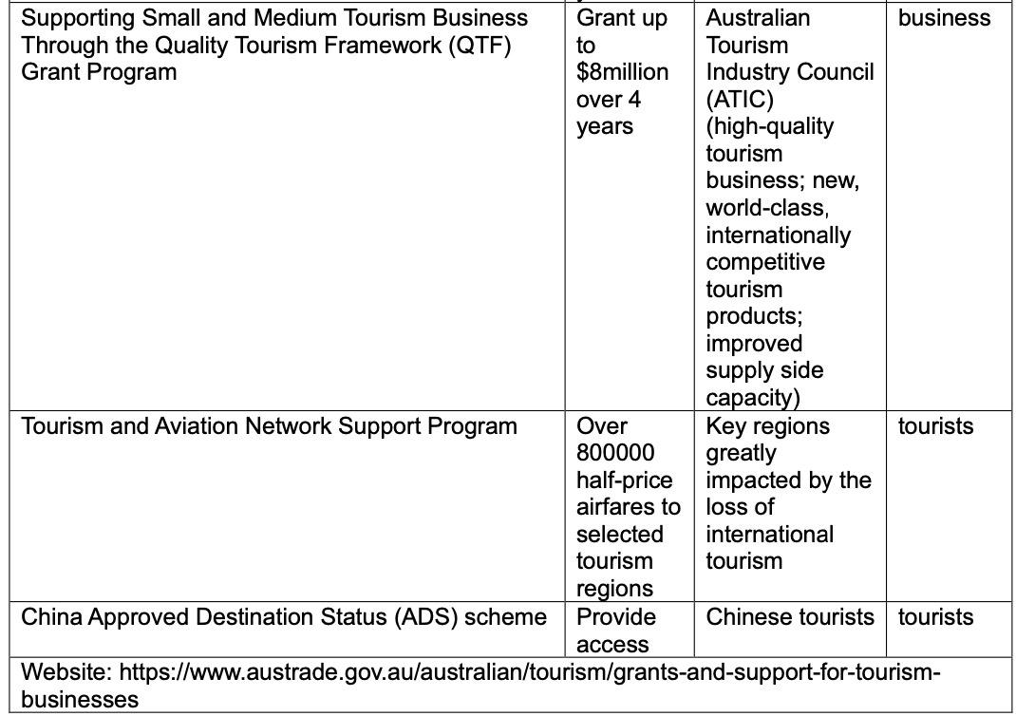
Connect model output with tourism support
Tourism support from federal government

Slide 15
Tourism support recommendations
Business
- reduce the travel cost of international and domestic tourists
Facilities
- Invest more in infrastructure
Labor force
- Provide tourism training, increase the market demand of labor force
Tourism investment
- Attract more foreign tourism investment

Slide 16
Travelling problem impact forecast- Feedback
Any improvements or suggestions on travelling problem impact forecast

Slide 17
The overall project framework - Business Close
Background: Covid-19
Methods to measure the impact of the support
A transition matrix-based neural network — lack of complete time series
Improved support success measurement visualizations/ dashboards
Python Automated Visualization
The Expected outcomes we could provided
Areas where support will be most needed
Provide recommendation of business support

Slide 18
Thank you !!!

